Slide 1


Slide 2
Local Anesthetics
DEFINITION
Drugs which
  produce a REVERSIBLE loss of sensation …
  in a localized part of the body…..
  when applied directly onto nerve tissues or mucous membranes
Local anesthetics are ‘local’ ONLY because of how they are administered! (Selectivity)

Slide 3
The first clinically used Local Anesthetic
Cocaine (ISA activity)
A natural alkaloid from Erythroxylum coca.
Prototype Drug Lignocaine (Synthetic)

Slide 4
Properties Desirable in a Local Anesthetic
Non-irritating
Do not cause permanent damage to nerve structure
Systemic toxicity should be low
Effective through-
Injected
or Applied locally
Onset of action as short as possible
DOA long enough to allow time for counter plated surgery

Slide 5
1. CLASSIFICATION ACCORDING TO CHEMICAL CHARACTERISTIC
ESTERS
  Cocaine
  Procaine
  Tetracaine
  Benzocaine
AMIDES
  Lignocaine/Lidocaine
  Bupivacaine
  Levobupivacaine
  Mepivacaine
  Prilocaine
  Etidocaine
  Ropivacaine

Slide 6
2. According to Duration of action
Short Duration of Action
Procaine
Medium Duration of Action
Cocaine, Lidocaine, Mepivacaine, Prilocaine
Long Duration of Action
Tetracaine, Bupivacaine, Etidocaine, Ropivacaine

Slide 7
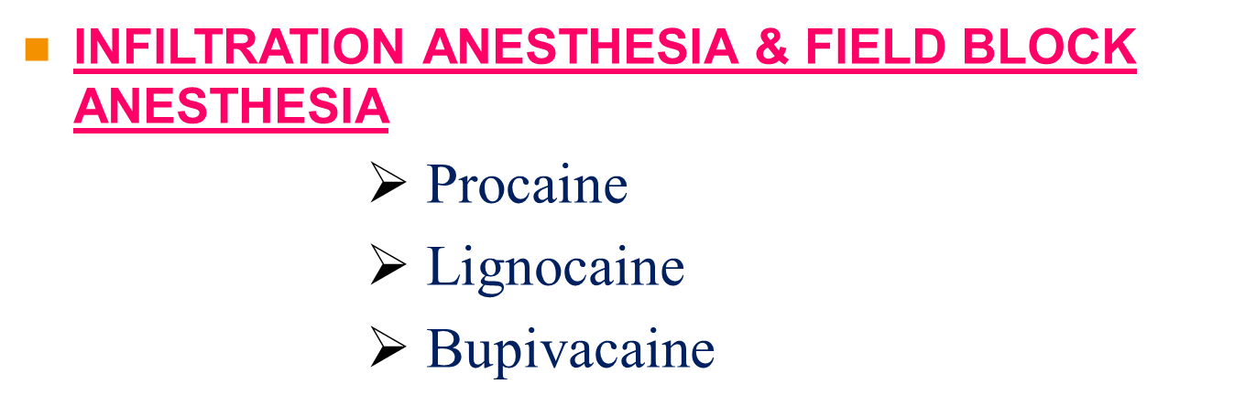
CLASSIFICATION ACCORDING TO CLINCIAL USES
SURFACE ANESTHESIA
Tetracaine
Cocaine
Benzocaine
Lignocaine

Slide 8
NERVE BLOCK ANESTHESIA
Procaine
Tetracaine
Lignocaine
Bupivacaine
Ropivacaine

Slide 9
SPINAL ANESTHESIA
Tetracaine
Lignocaine
Bupivacaine
EPIDURAL ANESTHESIA
  Lignocaine
  Bupivacaine
ANESTHETIC USED IN OPHTHALMOLOGY
  Proparacaine

Slide 10
Chemistry
Most local anesthetics consist of 3 parts
Lipophilic Aromatic group
Intermediate chain
Hydrophilic Amino group

Slide 11
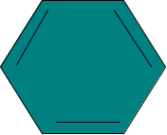
LAs - Weak Bases (pKa:7.5-9)
Intermediate chain
Aromatic portion
O
Amine portion
R
C
O
R
N
R
ESTER
O
R
NH
C
R
N
R
AMIDE
LIPOPHILIC
HYDROPHILIC

Slide 12
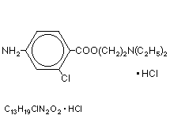
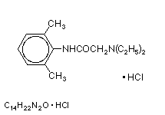
Two types of linkages give rise to 2 chemical classes of local anesthetics.
ESTER LINKAGE
AMIDE LINKAGE
PROCAINE
procaine (Novocaine)
tetracaine (Pontocaine)
benzocaine
cocaine
LIDOCAINE
lidocaine (Xylocaine)
mepivacaine (Carbocaine)
bupivacaine (Marcaine)
etidocaine (Duranest)
ropivacaine (Naropin)

Slide 13
MECHANISM OF ACTION
Diffusion into the nerve fiber
Blockade of sodium channels

Slide 14
Na⁺ equilibrium
Depolarization!
Action
Potential
+ 40 mv
+30
0
Threshold
Potential
Membrane Potential (mV)
K⁺ efflux
Na⁺ influx
-50
-70
Resting Membrane
Potential
Hyperpolarized
Time (msec)

Slide 15
Na⁺
LA receptor
+ +
+ +
- -
- -
- -
- -
- -
--
+ +
+ +
+ +
+ +
Resting (Closed**)
Open
(brief)
inactivated
LA have highest affinity for the inactivated form
Very slow repolarization in presence of LA
Refractory period
**Closed state may exist in various forms as it moves from resting to open. LA have a high affinity for the different closed forms and may prevent them from opening.

Slide 16
Progressively increasing conc. of a LA applied to a nerve fiber produce blockade of more & more Na+ channels :
The threshold for excitation increases
Impulse conduction slows
The rate of rise of AP declines
The AP amplitude decreases
Finally the ability to generate an AP is abolished

Slide 17
SUSCEPTIBILITY OF NERVE FIBER TO LAs DEPEND ON
Potency
Size of nerve fiber (small fibers blocked 1st)
Effect of fiber diameter
Rate of firing (rapidly firing fibers blocked 1st)
Effect of fiber position in the nerve bundle (outer fibers blocked 1st, then core fibers)

Slide 18
ORDER OF BLOCKADE
AUTONOMIC
PAIN
TEMPERATURE
TOUCH
DEEP PRESSURE
MOTOR
Recovery in reverse order

Slide 19
PHARMACOKINETICS
Absorption
Dosage
Site of injection (when used for major conduction blocks, the peak serum levels will vary as a function of the specific site of injection, with intercostal blocks among the highest, & sciatic & femoral among the lowest)
Lipid solubility (more lipid soluble – longer DOA)

Slide 20

PHARMACOKINETICS
Ph
Vascularity (highly vascular area – more rapid absorption – higher blood levels)
Combination with vasoconstrictors (resultant reduction in blood flow reduces rate of systemic absorption & diminishes peak serum levels)
Distribution
Biotransformation & Excretion

Slide 21
Comparison of LA characteristics
 | Relative lipid solubility | Relative potency | onset | pKa | Local duration | vasodilation | Plasma protein binding
procaine | 1 | 1 | slow | 8.9 | short | +++ | 5%
lidocaine | 4 | 4 | rapid | 7.9 | moderate | +++ | 55%
tetracaine | 80 | 16 | slow | 8.5 | long | + | 75%
bupivacaine | 130 | 16 | slow | 8.1 | long | + | 90%
Plasma protein binding may be used as an indirect measure of tissue binding tendencies

Slide 22
ADVERSE EFFECTS
CNS (1st stimulation, then depression)
Local Neurotoxicity (cauda equina syndrome associated with continuous spinal anesthesia – CSA)
CVS (bupivacaine – most cardiotoxic)
ANS
Motor Paralysis
Hematological Effects
Hypersensitivity reactions

Slide 23
Prevention of Toxicity
Enquire about history of allergy.
Caution in presence of liver/myocardial damage.
Proper site (correct knowledge of nerve course).
Minimal effective dose usage (avoid I/V adm).
Wait after injection.
Observe the face for any twitching, excitement, and pulse for tachycardia.
Observe post – op for allergic reactions.
Avoid food intake at least 04 hrs prior to anesthesia to prevent vomiting.

Slide 24
SELECTIVE PHARMACOLOGICAL PROPERTIES OF SOME ESTER - type LA
Cocaine
    Medical use limited to surface or topical anesthesia
    Avoid epinephrine because cocaine already has vasoconstrictor properties. (EXCEPTION!!!)
    A toxic action on heart may induce rapid and lethal cardiac failure.
    A marked pyrexia is associated with cocaine overdose.

Slide 25
SELECTIVE PHARMACOLOGICAL PROPERTIES OF SOME ESTER - type LA
Benzocaine
  pKa ~ 3,
  Available in many preps for relief of pain and irritation
  for surface anesthesia (topical) only ... ointments, sprays, etc.
  Used to produce anesthesia of mucous membranes
  Methemoglobinemia (Rare case side effect)

Slide 26
SELECTIVE PHARMACOLOGICAL PROPERTIES OF SOME AMIDE - type LA
LIDOCAINE (Xylocaine) Most widely used LA
  Effective by all routes.
  Faster onset, more intense, longer lasting, than procaine.
  Good alternative for those allergic to ester type
  More potent than procaine but about equal toxicity
  More sedative than others

Slide 27
SELECTIVE PHARMACOLOGICAL PROPERTIES OF SOME AMIDE - type LA
Bupivacaine (Marcaine)
  No topical effectiveness
  Slower onset and one of the longer duration agents
  Unique property of sensory and motor dissociation can provide sensory analgesia with minimal motor block
    has been popular drug for analgesia during labor
  More cardiotoxic than other LA

Slide 28
SELECTIVE PHARMACOLOGICAL PROPERTIES OF SOME AMIDE - type LA
Ropivacaine
  Enantiomer of bupivacaine (S stereoisomer)
  No topical effectiveness
  Clinically ~ equivalent to bupivacaine
  Similar sensory versus motor selectivity as bupivacaine with significantly less CV toxicity

Slide 29
CLINICAL APPLICATIONS
SURFACE ANESTHESIA (Topical)
  Ear,Nose, mouth, bronchial tree, nasopharynx,cornea, GIT and urinary tracts
    Lidocaine, tetracaine, Benzocaine
    EMLA cream (Eutectic Mixture of Local Anesthetics) lidocaine 2.5% + prilocaine 2.5% permits anesthetic penetration of keratinized layer of skin as deep as 5mm, producing localized numbness.

Slide 30
Clinical Applications
INFILTRATION ANESTHESIA
  Direct injection into tissues to reach nerve branches and terminals.
  Can be superficial as well as deep.
  Used in minor surgery.
  Immediate onset with variable duration.
  This type involve skin region as deep as intra abdominal tissue.
    .Most LA’s used

Slide 31
Clinical Applications
NERVE BLOCK or FIELD BLOCK
  Interruption of nerve conduction upon injection into the region of nerve plexus or trunk.
  Used for surgery, dentistry, analgesia.
  Less anesthetic needed than for infiltration
  Given within specific nerve area such as brachial plexus, within intercostal nerves, abdominal nerves are targeted, cervical plexus when neck region is targeted.
    .Most LA’s used

Slide 32
Clinical Applications
SPINAL ANESTHESIA
  Injection into subarachnoid space below level of L2 vertebra to produce effect in spinal roots and spinal cord.
  Use hyperbaric or hypobaric solutions depending on area of blockade.
  Used for surgery to abdomen, pelvis or leg when can’t use general anesthesia.
  Can be employed in pts of hepatic, renal & CVS diseases
    Lidocaine, tetracaine

Slide 33
Clinical Applications
EPIDURAL AND CAUDAL ANESTHESIA
  Injection into epidural space usually at lumbar or sacral levels or near dura matter where nearly most nerves pass closely. Areas supplied by these nerves are targeted e.g.
  .ligamentum flavum(post)
  .spinal periosteum(laterally), dura(ant).
  Lower part of the body. Pelvic region
  For painless child birth.

Slide 34
Clinical Applications
  Unwanted effects similar to that of spinal (pain, hematoma, introduction of foreign particle, hypotension – Rx: raise foot-end of bed or give sympathomimetics, headache – Rx: small bore needle & blood patch, cauda equina syndrome, rarely respiratory paralysis)
    Lidocaine, bupivacaine, ropivacaine

Slide 35


